Slide 1
CS 179: GPU Programming
Lecture 9 / Homework 3

Slide 2
Recap
Some algorithms are “less obviously parallelizable”:
Reduction
Sorts
FFT (and certain recursive algorithms)

Slide 3
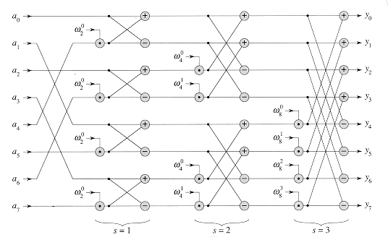
Parallel FFT structure (radix-2)
Bit-reversed access
Stage 1
Stage 2
Stage 3
http://staff.ustc.edu.cn/~csli/graduate/algorithms/book6/chap32.htm

Slide 4
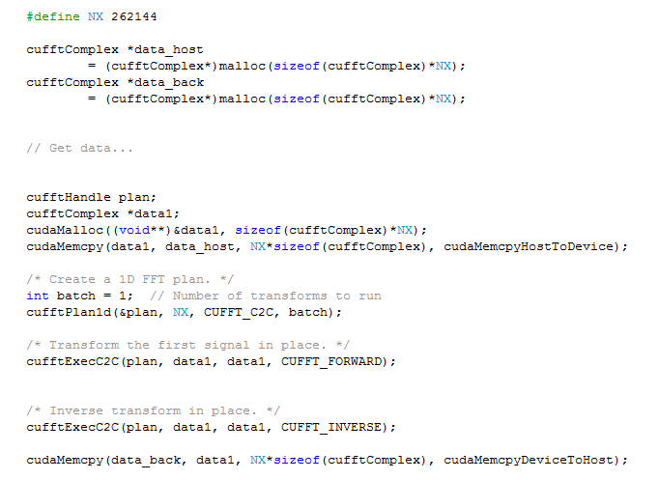
cuFFT 1D example
Correction: Remember to use cufftDestroy(plan) when finished with transforms

Slide 5
Today
Homework 3
Large-kernel convolution

Slide 6
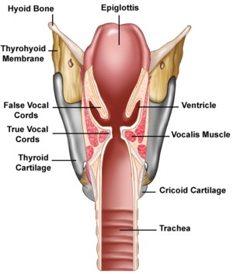
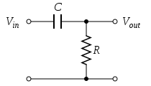
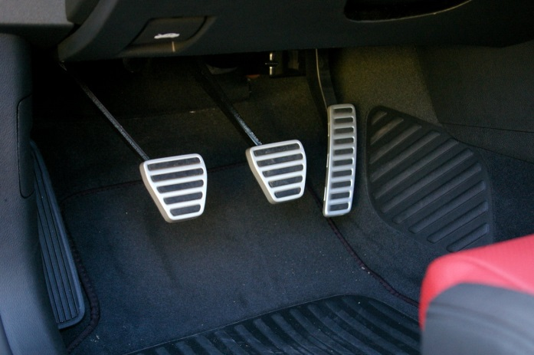
Systems
Given input signal(s), produce output signal(s)

Slide 7
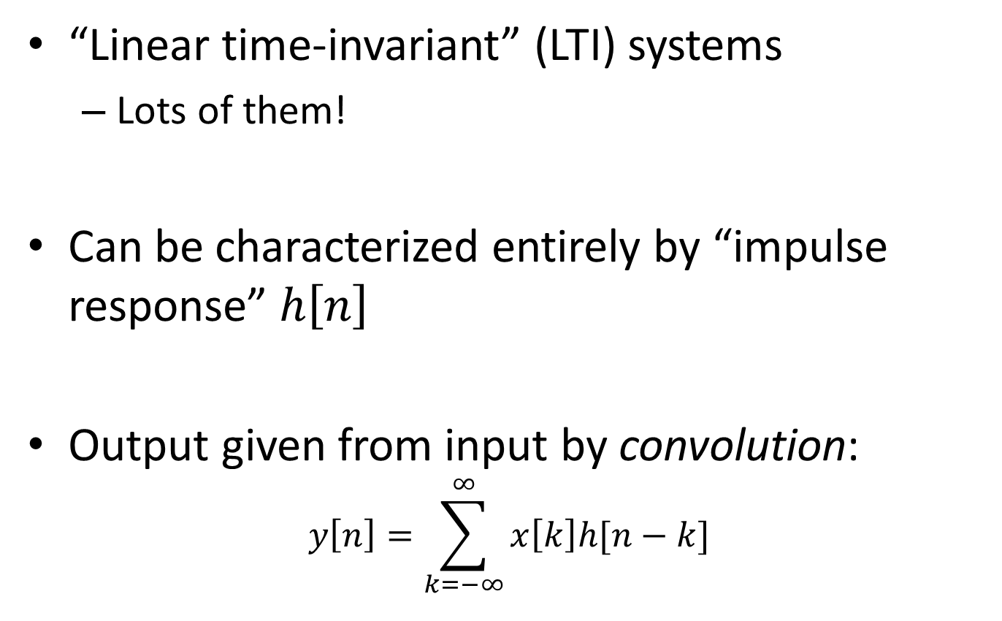
LTI system review (Week 1)
“Linear time-invariant” (LTI) systems
Lots of them!
Can be characterized entirely by “impulse response” $h\left[n\right]$
Output given from input by convolution:
$$y\left[n\right]=\sum_{k=−∞}^{∞}{x\left[k\right]h[n−k]}$$

Slide 8
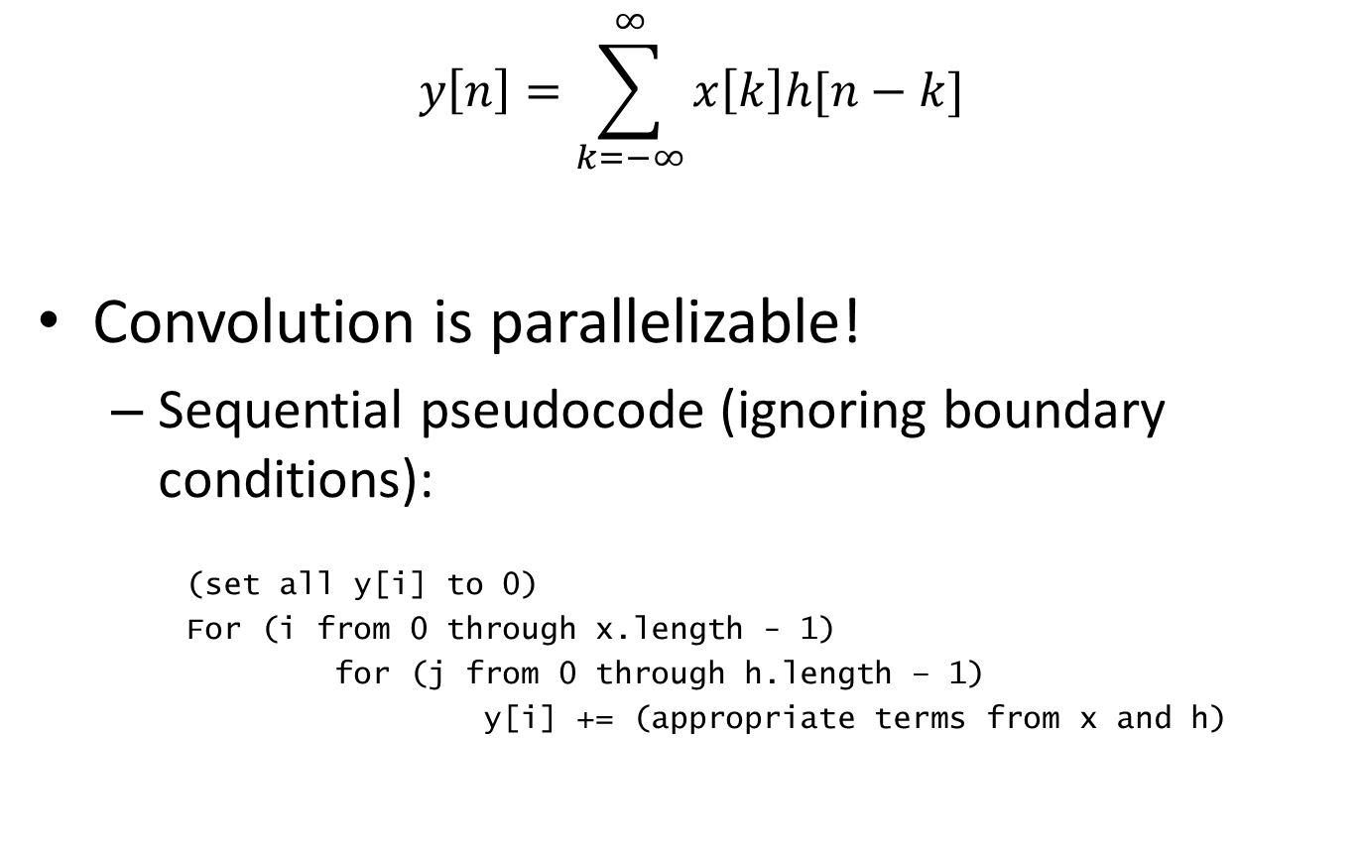
Parallelization
$$y\left[n\right]=\sum_{k=−∞}^{∞}{x\left[k\right]h[n−k]}$$
Convolution is parallelizable!
Sequential pseudocode (ignoring boundary conditions):
(set all y[i] to 0)
For (i from 0 through x.length - 1)
for (j from 0 through h.length – 1)
y[i] += (appropriate terms from x and h)

Slide 9
A problem…
This worked for small impulse responses
E.g. h[n], 0 ≤ n ≤ 20 in HW 1
Homework 1 was “small-kernel convolution”:
(Vocab alert: Impulse responses are often called “kernels”!)

Slide 10
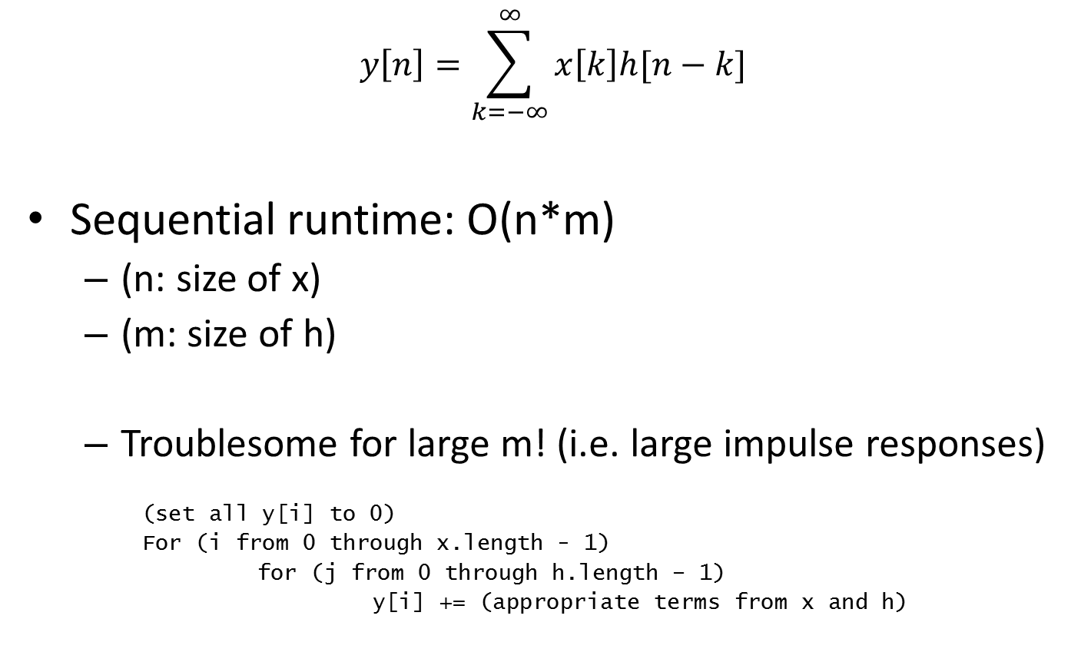
A problem…
$$y\left[n\right]=\sum_{k=−∞}^{∞}{x\left[k\right]h[n−k]}$$
Sequential runtime: O(n*m)
(n: size of x)
(m: size of h)
Troublesome for large m! (i.e. large impulse responses)
(set all y[i] to 0)
For (i from 0 through x.length - 1)
for (j from 0 through h.length – 1)
y[i] += (appropriate terms from x and h)

Slide 11

DFT/FFT
Same problem with Discrete Fourier Transform!
Successfully optimized and GPU-accelerated!
O(n²) to O(n log n)
Can we do the same here?

Slide 12
“Circular” convolution
“equivalent” of convolution for periodic signals

Slide 13
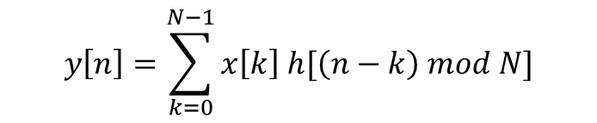
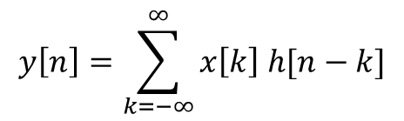
“Circular” convolution
Linear convolution:
Circular convolution:
$$y\left[n\right]=\sum_{k=−∞}^{∞}{x\left[k\right] h[n−k]}$$
$$y\left[n\right]=\sum_{k=0}^{N−1}{x\left[k\right] h[\left(n−k\right) mod N]}$$

Slide 14
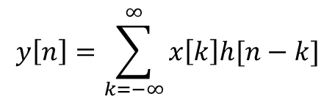
Example:
x0 | x1 | x2 | x3
h0 | h1 | 0 | 0
$$y\left[n\right]=\sum_{k=−∞}^{∞}{x\left[k\right]h[n−k]}$$
x[0..3], h[0..1]
Linear convolution:
y[0] = x[0]h[0]
0 | 0 | x0 | x1 | x2 | x3 | 0 | 0
0 | h1 | h0 | 0 | 0 | 0 | 0 | 0

Slide 15
Example:
x0 | x1 | x2 | x3
h0 | h1 | 0 | 0
$$y\left[n\right]=\sum_{k=−∞}^{∞}{x\left[k\right]h[n−k]}$$
x[0..3], h[0..1]
Linear convolution:
y[0] = x[0]h[0]
y[1] = x[0]h[1] + x[1]h[0]
0 | 0 | x0 | x1 | x2 | x3 | 0 | 0
0 | h1 | h0 | 0 | 0 | 0 | 0 | 0
0 | 0 | x0 | x1 | x2 | x3 | 0 | 0
0 | 0 | h1 | h0 | 0 | 0 | 0 | 0

Slide 16
Example:
x0 | x1 | x2 | x3
h0 | h1 | 0 | 0
$$y\left[n\right]=\sum_{k=−∞}^{∞}{x\left[k\right]h[n−k]}$$
x[0..3], h[0..1]
Linear convolution:
y[0] = x[0]h[0]
y[1] = x[0]h[1] + x[1]h[0]
y[2] = x[1]h[1] + x[2]h[0]
y[3] = x[2]h[1] + x[3]h[0]
0 | 0 | x0 | x1 | x2 | x3 | 0 | 0
0 | h1 | h0 | 0 | 0 | 0 | 0 | 0
0 | 0 | x0 | x1 | x2 | x3 | 0 | 0
0 | 0 | 0 | h1 | h0 | 0 | 0 | 0

Slide 17
Example:
x0 | x1 | x2 | x3
h0 | h1 | 0 | 0
$$y\left[n\right]=\sum_{k=−∞}^{∞}{x\left[k\right]h[n−k]}$$
x[0..3], h[0..1]
Linear convolution:
y[0] = x[0]h[0]
y[1] = x[0]h[1] + x[1]h[0]
y[2] = x[1]h[1] + x[2]h[0]
y[3] = x[2]h[1] + x[3]h[0]
y[4] = x[3]h[1] + x[4]h[0]
0 | 0 | x0 | x1 | x2 | x3 | 0 | 0
0 | 0 | 0 | 0 | h1 | h0 | 0 | 0

Slide 18
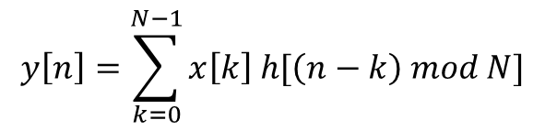
Example:
x0 | x1 | x2 | x3
h0 | h1 | 0 | 0
$$y\left[n\right]=\sum_{k=−∞}^{∞}{x\left[k\right]h[n−k]}$$
x[0..3], h[0..1]
Linear convolution:
y[0] = x[0]h[0]
y[1] = x[0]h[1] + x[1]h[0]
y[2] = x[1]h[1] + x[2]h[0]
y[3] = x[2]h[1] + x[3]h[0]
y[4] = x[3]h[1] + x[4]h[0]
Circular convolution:
y[0] = x[3]h[1] + x[0]h[0] + x[1]h[3] + x[2]h[2]
y[1] = x[0]h[1] + x[1]h[0] + x[2]h[3] + x[3]h[2]
y[2] = x[1]h[1] + x[2]h[0] + x[3]h[3] + x[0]h[2]
y[3] = x[2]h[1] + x[3]h[0] + x[0]h[3] + x[1]h[2]
0 | 0 | x0 | x1 | x2 | x3 | 0 | 0
0 | h1 | h0 | 0 | 0 | 0 | 0 | 0
$$y\left[n\right]=\sum_{k=0}^{N−1}{x\left[k\right] h[\left(n−k\right) mod N]}$$
x0 | x1 | x2 | x3
h0 | 0 | 0 | h1

Slide 19
Padding
x[n] and h[n] are different lengths?
h[2] and h[3] are undefined in the previous slide
We will treat them as zeros
To do this, store h and x in bigger arrays
Pad them with enough zeros so they both have length at least N = x.length + h.length - 1

Slide 20
Padding
x[n] and h[n] are different lengths?
h[2] and h[3] are undefined in the previous slide
We will treat them as zeros
To do this, store h and x in bigger arrays
Pad them with enough zeros so they both have length at least N = x.length + h.length - 1
This will let us linearly convolve using circular convolution

Slide 21
Example: (Padding)
$$y\left[n\right]=\sum_{k=−∞}^{∞}{x\left[k\right]h[n−k]}$$
x[0..3], h[0..1]
Linear convolution:
y[0] = x[0]h[0]
y[1] = x[0]h[1] + x[1]h[0]
y[2] = x[1]h[1] + x[2]h[0]
y[3] = x[2]h[1] + x[3]h[0]
y[4] = x[3]h[1] + x[4]h[0]
Circular convolution:
y[0] = x[3]h[1] + x[0]h[0] + x[1]h[3] + x[2]h[2]
y[1] = x[0]h[1] + x[1]h[0] + x[2]h[3] + x[3]h[2]
y[2] = x[1]h[1] + x[2]h[0] + x[3]h[3] + x[0]h[2]
y[3] = x[2]h[1] + x[3]h[0] + x[0]h[3] + x[1]h[2]
$$y\left[n\right]=\sum_{k=0}^{N−1}{x\left[k\right] h[\left(n−k\right) mod N]}$$

Slide 22
Example: (Padding)
$$y\left[n\right]=\sum_{k=−∞}^{∞}{x\left[k\right]h[n−k]}$$
x[0..3], h[0..1]
Linear convolution:
y[0] = x[0]h[0]
y[1] = x[0]h[1] + x[1]h[0]
y[2] = x[1]h[1] + x[2]h[0]
y[3] = x[2]h[1] + x[3]h[0]
y[4] = x[3]h[1] + x[4]h[0]
Circular convolution:
y[0] = x[4]h[1] + x[0]h[0] + x[1]h[4] + x[2]h[3] + x[3]h[2]
y[1] = x[0]h[1] + x[1]h[0] + x[2]h[4] + x[3]h[3] + x[4]h[2]
y[2] = x[1]h[1] + x[2]h[0] + x[3]h[4] + x[4]h[3] + x[0]h[2]
y[3] = x[2]h[1] + x[3]h[0] + x[4]h[4] + x[0]h[3] + x[1]h[2]
y[4] = x[3]h[1] + x[4]h[0] + x[0]h[4] + x[1]h[3] + x[2]h[2]
N is now (4 + 2 – 1) = 5
$$y\left[n\right]=\sum_{k=0}^{N−1}{x\left[k\right] h[\left(n−k\right) mod N]}$$

Slide 23
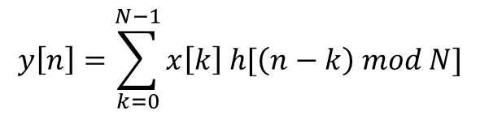

Circular Convolution Theorem*
Can be calculated by: IFFT( FFT(x) .* FFT(h) )
i.e.
$$\overset{⃑}{X}=FFT(\overset{⃑}{x})$$
$$\overset{⃑}{H}=FFT(\overset{⃑}{h})$$
For all i:
$$Y_{i}=X_{i}H_{i}$$
Then:
$$\overset{⃑}{y}=IFFT(\overset{⃑}{Y})$$
$$y\left[n\right]=\sum_{k=0}^{N−1}{x\left[k\right] h[\left(n−k\right) mod N]}$$
* DFT case

Slide 24
Circular Convolution Theorem*
Can be calculated by: IFFT( FFT(x) .* FFT(h) )
i.e.
$$\overset{⃑}{X}=FFT(\overset{⃑}{x})$$
$$\overset{⃑}{H}=FFT(\overset{⃑}{h})$$
For all i:
$$Y_{i}=X_{i}H_{i}$$
Then:
$$\overset{⃑}{y}=IFFT(\overset{⃑}{Y})$$
$$y\left[n\right]=\sum_{k=0}^{N−1}{x\left[k\right] h[\left(n−k\right) mod N]}$$
O(n log n) Assume n > m
O(m log m)
O(n)
O(n log n)
Total:
O(n log n)
* DFT case

Slide 25
Summary
Alternate algorithm for large impulse response convolution!
Serial: O(n log n) vs. O(mn)
Small vs. large m determines algorithm choice
Runtime does “carry over” to parallel situations (to some extent)

Slide 26
Homework 3, Part 1
Implement FFT (“large-kernel”) convolution
Use cuFFT for FFT/IFFT (if brave, try your own)
Use “batch” variable to save FFT calculations Correction: Good practice in general, but results in poor performance on Homework 3
Don’t forget padding
Complex multiplication kernel:
Multiply the FFT values pointwise!

Slide 27
Complex numbers
cufftComplex: cuFFT complex number type
Example usage:
cufftComplex a;
a.x = 3; // Real part
a.y = 4; // Imaginary part
Complex Multiplication:
(a + bi)(c + di) = (ac - bd) + (ad + bc)i

Slide 28
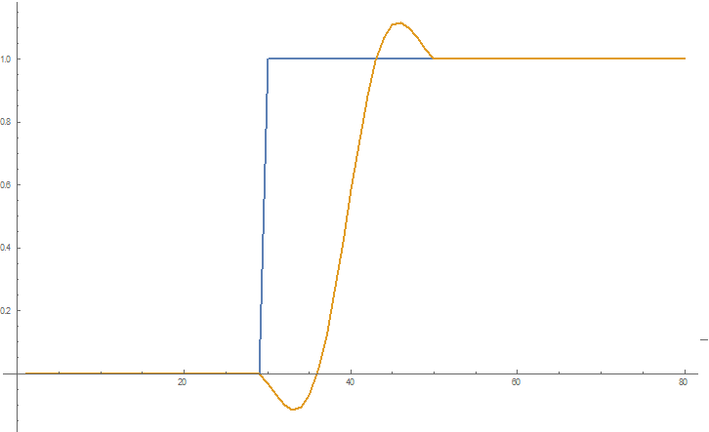
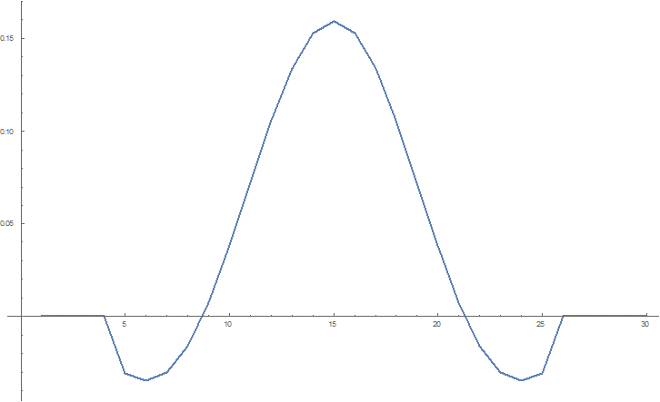
Homework 3, Part 2
For a normalized Gaussian filter, output values cannot be larger than the largest input
Not true in general
Low Pass Filter
Test Signal and Response

Slide 29
Normalization
Amplitudes must lie in range [-1, 1]
Normalize s.t. maximum magnitude is 1 (or 1 - ε)
How to find maximum amplitude?

Slide 30
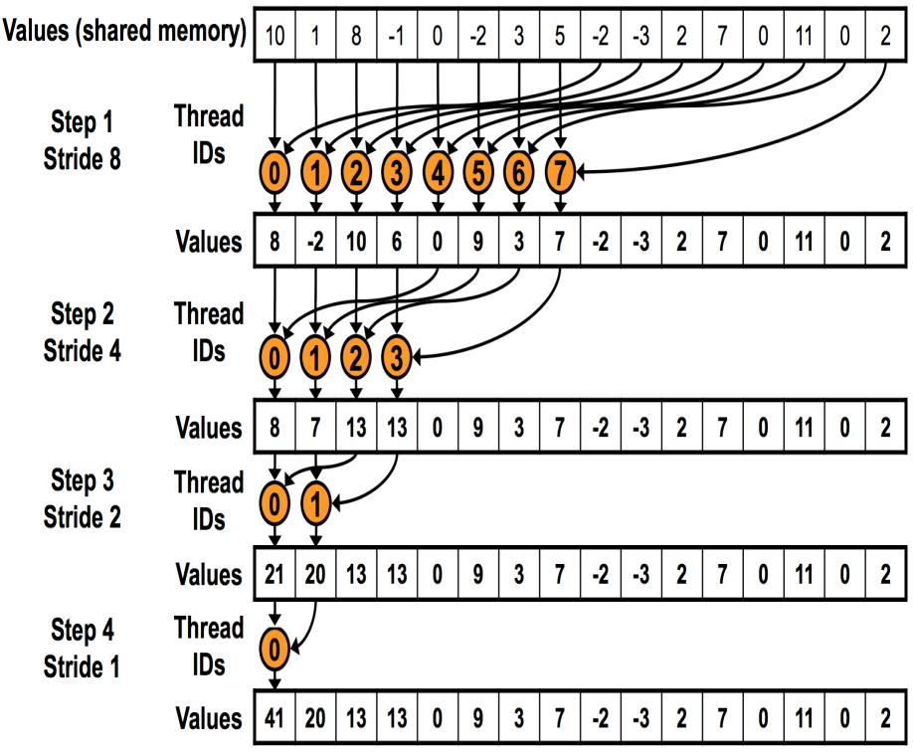
Reduction
This time, maximum (instead of sum)
Lecture 7 strategies
“Optimizing Parallel Reduction in CUDA” (Harris)

Slide 31
Homework 3, Part 2
Implement GPU-accelerated normalization
Find maximum (reduction)
The max amplitude may be a negative sample
Divide by maximum to normalize

Slide 32
(Demonstration)
Rooms can be modeled as LTI systems!

Slide 33
Other notes
Machines:
Normal mode: titan, haru, mako, mx, minuteman
Audio mode: titan, haru, mako
Due date:
Wednesday (4/25), 3 PM

